Slide 1
Customer Returns
WMS Guide

Slide 2
Table of Contents
Prerequisite ………………….............................................................................................3
Inbound Return Planning.............................................................................................5
Inbound Return Receiving...........................................................................................9

Slide 3
Prerequisite

Slide 4
Prerequisite
A Return Merchandise Authorization (RMA) is required before initiating a customer return in the WMS.
It is the responsibility of CSR to generate an RMA number.
Once the RMA number created, the customer return process is partly performed on a desktop and/or a mobile device.

Slide 5
Step 1 – Inbound Return Planning

Slide 6
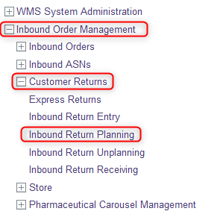
Step 1 – Inbound Return Planning
With a desktop computer, select the Inbound Order Management resource
Under Customer Returns, click on Inbound Return Planning

Slide 7
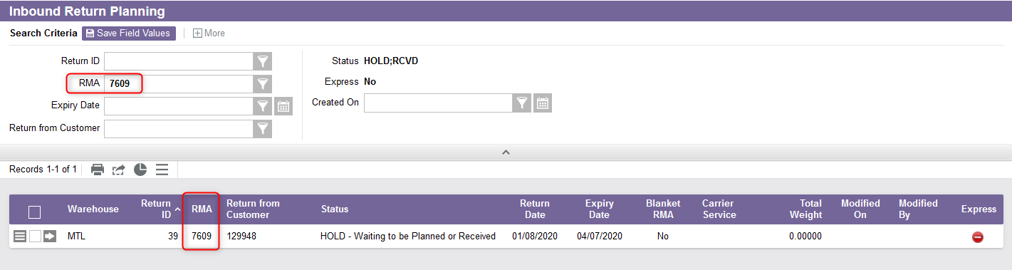
Step 1 – Inbound Return Planning
From the new window, use the search criteria to retrieve the return you wish to process using the RMA number.

Slide 8
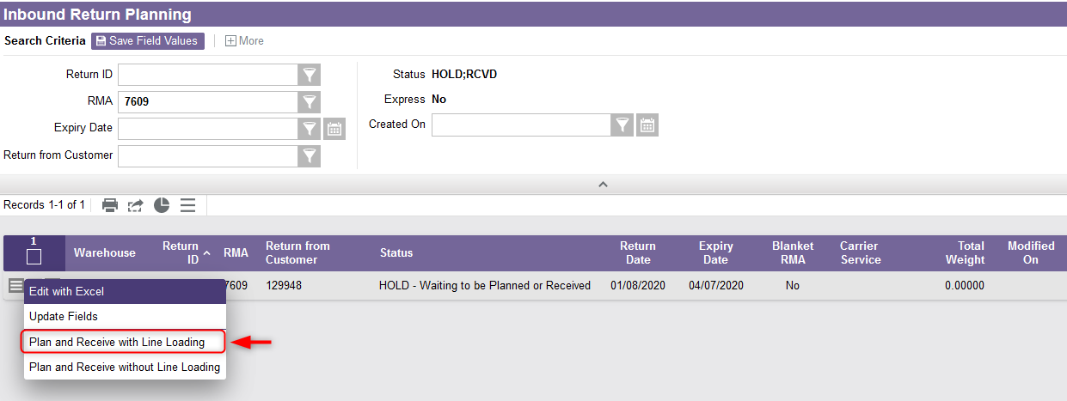
Step 1 – Inbound Return Planning
Select the Use Record as Criteria for Action button and click on the Plan and Receive with Line Loading action.

Slide 9
Step 2 – Inbound Return Receiving

Slide 10
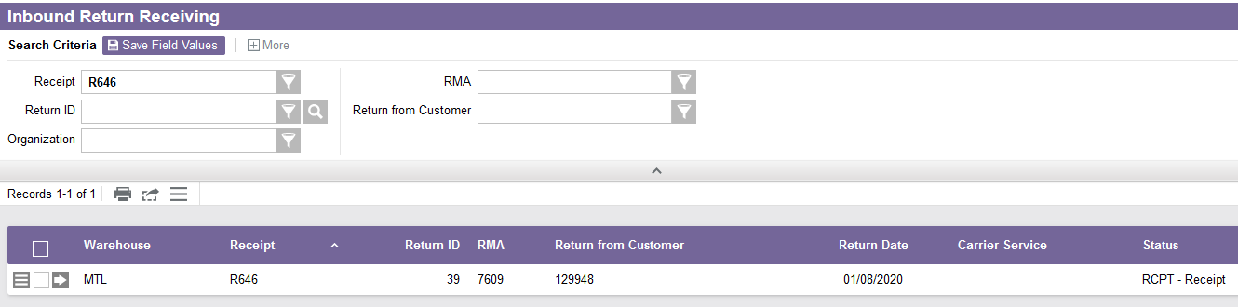
Step 2 – Inbound Return Receiving
If you are using a desktop computer, a new Inbound Return Receiving window will appear automatically showing the RMA you previously planned.

Slide 11
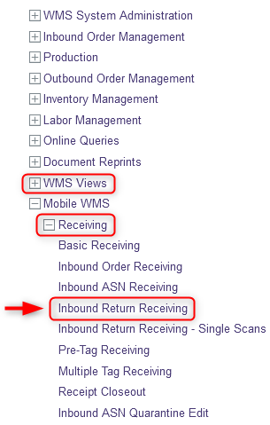
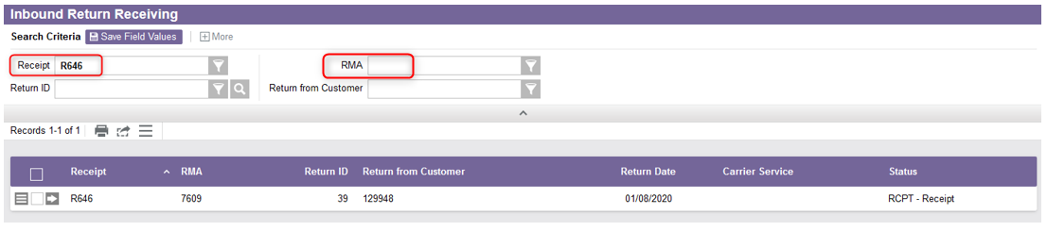
Step 2 – Inbound Return Receiving
If you want to perform the receiving of the customer return with a mobile device, under the Receiving resource, select Inbound Return Receiving. Then retrieve the RMA you want to process using the Receipt or the RMA number.

Slide 12
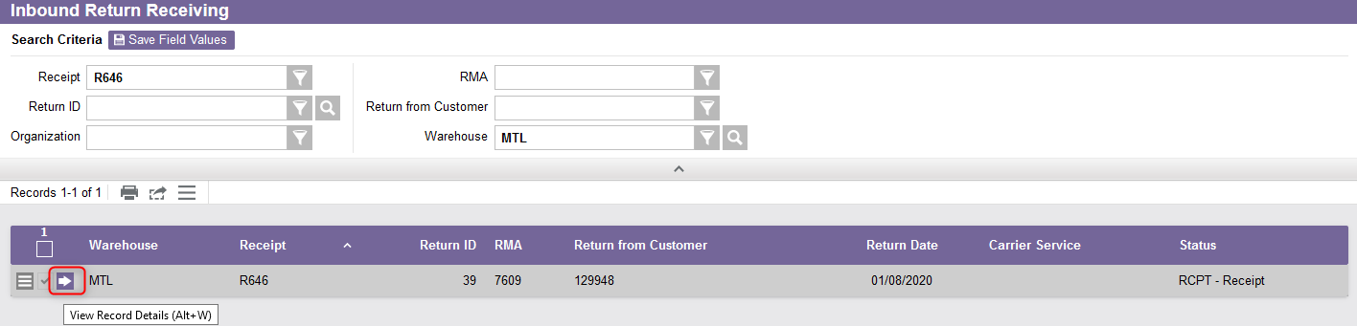
Step 2 – Inbound Return Receiving
Select the View Record Details action.

Slide 13
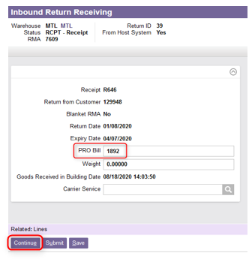
Step 2 – Inbound Return Receiving
Optionally, from the new window, enter the Pro Bill number.
Click on Continue.

Slide 14
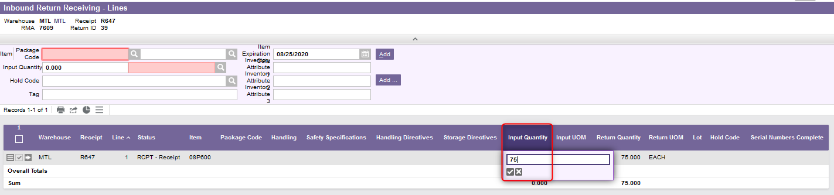
Step 2 – Inbound Return Receiving
In the new window, enter the quantity that must be returned for each line items.

Slide 15
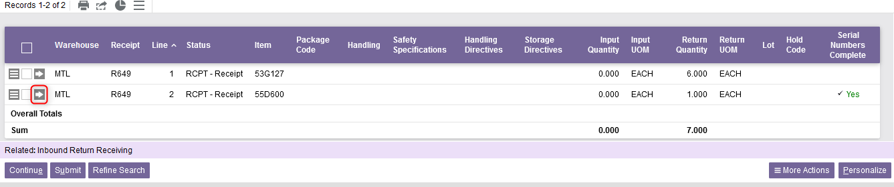
Step 2 – Inbound Return Receiving
In the case of an item with a serial number, you need to add this Serial Number when processing the return:
  Click on the View Record Details action.

Slide 16
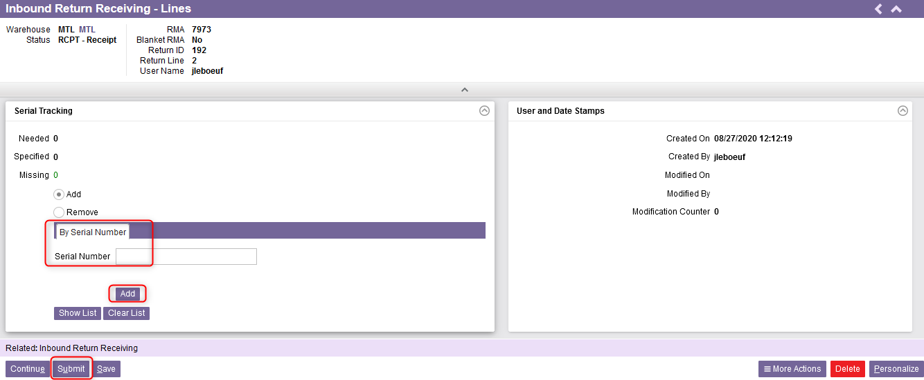
Step 2 – Inbound Return Receiving
In the case of an item with a serial number (continued):
  Confirm the quantity as well as the unit of measure,
  In the Serial Tracking Section:
    Enter the Serial Number,
    Click on Add,
    Then, click on Submit.

Slide 17
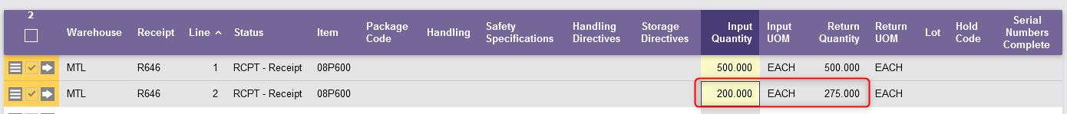
Step 2 – Inbound Return Receiving
Additional note - Receive less than the expected return quantity :
If the quantity is partially received (in the "Input Quantity" field) compared to what was expected (in the "Return Quantity" field), the RMA will be kept open.
A new line for the customer return will be created allowing the return to be processed later for the remaining quantities. The RMA number will remain the same.
If the remaining quantities will no longer be received, it is the responsibility of CSR to cancel the RMA.

Slide 18
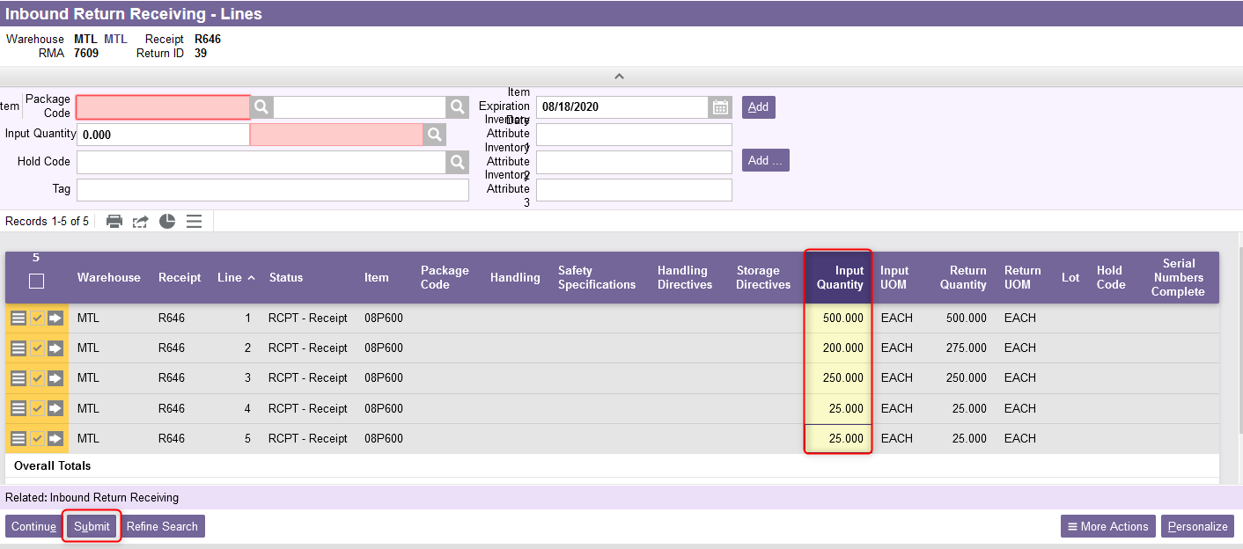
Step 2 – Inbound Return Receiving
Once all quantities (and serial numbers if applicable) have been entered for all line of items, click on Submit.

Slide 19
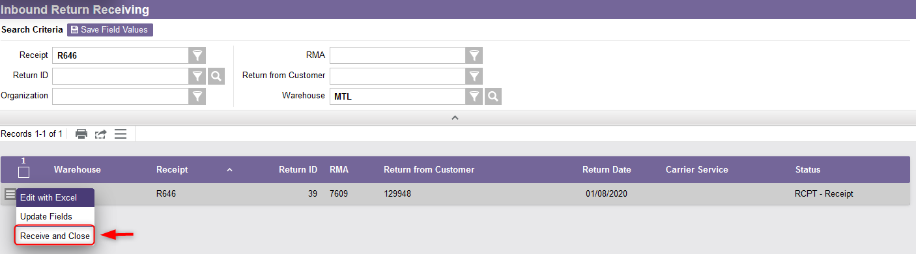
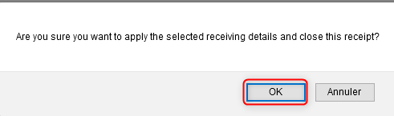
Step 2 – Inbound Return Receiving
Finally, select the Use Record as Criteria for Action button and click on the Receive and Close action.
A message will appear for you to confirm the action, select OK.
This end the process of inbound return receiving.

